Slide 1

Data Structures Using C++ 2E
Chapter 1
Software Engineering Principles and C++ Classes
Data Structures Using C++ 2E

Slide 2
Textbook Programs Download
www.cengage.com
Search the book using keywords “Malik Data Structure C++”
You will get to this link to download the self extracting .exe file (for Windows)
http://www.wadsworth.com/cgi-wadsworth/course_products_wp.pl?fid=M20b&product_isbn_issn=9780324782011&token=
Data Structures Using C++ 2E

Slide 3
Objectives
Learn about software engineering principles
Discover what an algorithm is and explore problem-solving techniques
Become aware of structured design and object-oriented design programming methodologies
Learn about classes
Become aware of private, protected, and public members of a class
Data Structures Using C++ 2E

Slide 4
Objectives (cont’d.)
Explore how classes are implemented
Become aware of Unified Modeling Language (UML) notation
Examine constructors and destructors
Become aware of an abstract data type (ADT)
Explore how classes are used to implement ADTs
Data Structures Using C++ 2E

Slide 5
Software Life Cycle
Program life cycle
  Many phases between program conception and retirement
  Three fundamental stages
    Development, deployment (use), and maintenance
Program retirement
  Program too expensive to maintain
    No new version released
Software development phase
  First and most important software life cycle phase
Data Structures Using C++ 2E

Slide 6
Software Development Phase
Four phases
  Requirements and Analysis
  Design
  Implementation
  Testing and debugging
Requirements and Analysis
  First and most important step
  Analysis requirements
    Thoroughly understand the problem
    Understand the problem requirements
    Divide problem into subproblems (if complex)
    Use cases
Data Structures Using C++ 2E

Slide 7
Software Development Phase (cont’d.)
Design
  Design an algorithm to solve the problem or subproblem
  Algorithm
    Step-by-step problem-solving process
    Solution obtained in finite amount of time
  Structured design
    Dividing problem into smaller subproblems
    Also known as: top-down design, stepwise refinement, and modular programming
Data Structures Using C++ 2E

Slide 8
Software Development Phase (cont’d.)
Design (cont’d.)
  Object-oriented design (OOD)
    Identifies components called objects
    Determines how objects interact with one another
    Object specifications: relevant data; possible operations performed on that data
  Object-oriented programming (OOP) language
    Programming language implementing OOD
  Object-oriented design principles
    Encapsulation, inheritance, and polymorphism
    Reuse and extend
Data Structures Using C++ 2E

Slide 9
Object-oriented Design Principles
Encapsulation
  Ability to combine data and operations
Inheritance
  Encourages code reuse
Polymorphism
  Occurs through function overloading, operator overloading, and templates
Data Structures Using C++ 2E

Slide 10
Software Development Phase (cont’d.)
Implementation
  Write and compile programming code
    Implement classes and functions discovered in the design phase
  Final program consists of several functions
    Each accomplishes a specific goal
  Precondition
    Statement specifying condition(s)
    Must be true before function called
  Postcondition
    Statement specifying true items after function call completed
Data Structures Using C++ 2E

Slide 11
Software Development Phase (cont’d.)
Testing and debugging
  Testing
    Testing program correctness
    Verifying program works properly
  Increase program reliability
    Discover and fix errors before releasing to user
  Test case
    Set of inputs, user actions, other initial conditions, and the expected output
    Document properly
  Black-box testing and white-box testing
Data Structures Using C++ 2E

Slide 12
Algorithm Analysis: The Big-O Notation
Analyze algorithm after design
Example
  50 packages delivered to 50 different houses
  50 houses one mile apart, in the same area
FIGURE 1-1 Gift shop and each dot representing a house
Data Structures Using C++ 2E

Slide 13
Algorithm Analysis: The Big-O Notation (cont’d.)
Example (cont’d.)
  Driver picks up all 50 packages
  Drives one mile to first house, delivers first package
  Drives another mile, delivers second package
  Drives another mile, delivers third package, and so on
  Distance driven to deliver packages
    1+1+1+… +1 = 50 miles
  Total distance traveled: 50 + 50 = 100 miles
FIGURE 1-2 Package delivering scheme
Data Structures Using C++ 2E

Slide 14

Algorithm Analysis: The Big-O Notation (cont’d.)
Example (cont’d.)
  Similar route to deliver another set of 50 packages
    Driver picks up first package, drives one mile to the first house, delivers package, returns to the shop
    Driver picks up second package, drives two miles, delivers second package, returns to the shop
  Total distance traveled
    2 * (1+2+3+…+50) = 2550 miles
FIGURE 1-3 Another package delivery scheme
Data Structures Using C++ 2E

Slide 15
Algorithm Analysis: The Big-O Notation (cont’d.)
Example (cont’d.)
  n packages to deliver to n houses, each one mile apart
  First scheme: total distance traveled
    1+1+1+… +n = 2n miles
    Function of n
  Second scheme: total distance traveled
    2 * (1+2+3+…+n) = 2*(n(n+1) / 2) = n²+n
    Function of n²
Data Structures Using C++ 2E

Slide 16
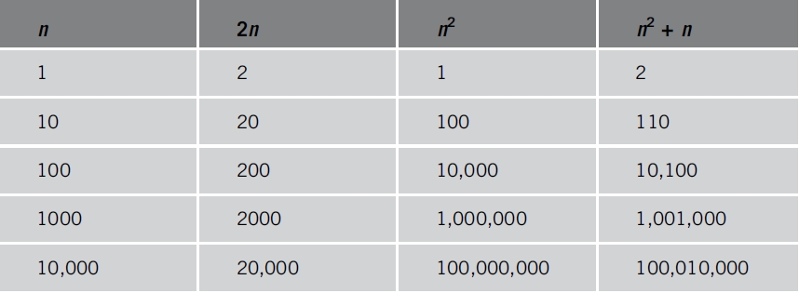
Algorithm Analysis: The Big-O Notation (cont’d.)
Analyzing an algorithm
  Count number of operations performed
    Not affected by computer speed
TABLE 1-1 Various values of n, 2n, n², and n² + n
Data Structures Using C++ 2E

Slide 17
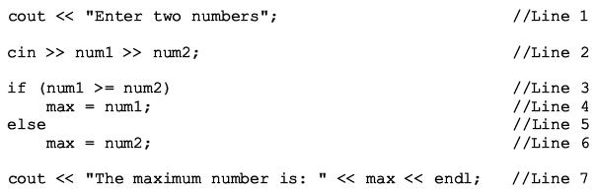
Algorithm Analysis: The Big-O Notation (cont’d.)
Example 1-1
  Illustrates fixed number of executed operations
  Total number of operation is 8
Data Structures Using C++ 2E

Slide 18
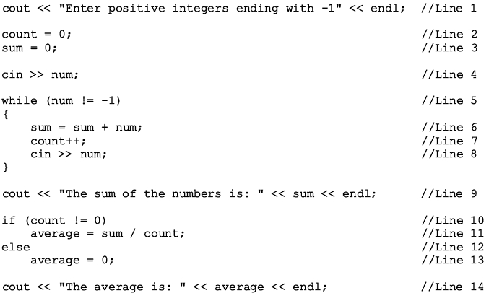
Algorithm Analysis: The Big-O Notation (cont’d.)
Example 1-2
  Illustrates dominant operations
Data Structures Using C++ 2E

Slide 19
Algorithm Analysis: The Big-O Notation (cont’d.)
Lines 1 through 4 before while have 5 operations
Line 5 has one operation, and 4 operations within the while loop
9 or 8 operations after the while loop
If while look executes 10 times, total number of operations is:
  10*5 + 1 + 5 + 9 or 10*5 + 1 + 5 + 8
Generalize the case when the while loop executes n times
  5n + 15 or 5n + 14
For very large value of n, the term 5n becomes the dominating term and the terms 15 and 14 become negligible
Data Structures Using C++ 2E

Slide 20
Algorithm Analysis: The Big-O Notation (cont’d.)
Search algorithm
  n: represents list size
  f(n): count function
    Number of comparisons in search algorithm
  c: units of computer time to execute one operation
  cf(n): computer time to execute f(n) operations
  Constant c depends computer speed (varies)
  f(n): number of basic operations (constant)
  Determine algorithm efficiency
    Knowing how function f(n) grows as problem size grows
Data Structures Using C++ 2E

Slide 21
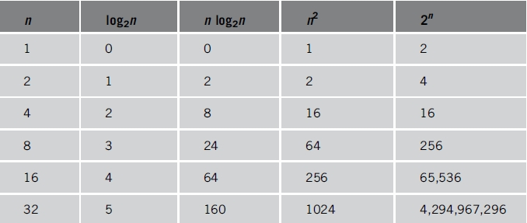
Algorithm Analysis: The Big-O Notation (cont’d.)
TABLE 1-2 Growth rates of various functions
Data Structures Using C++ 2E

Slide 22
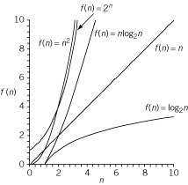
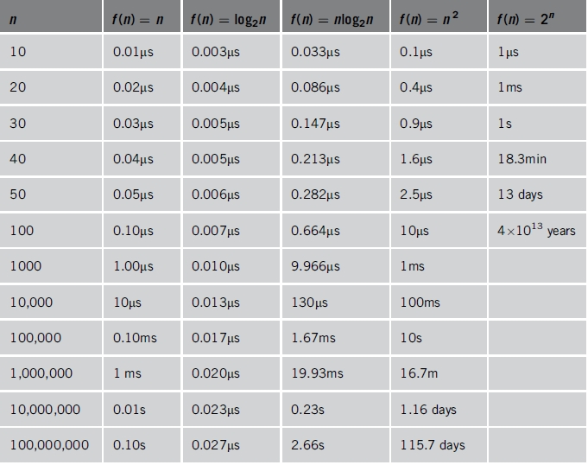
Algorithm Analysis: The Big-O Notation (cont’d.)
TABLE 1-3 Time for f(n) instructions on a computer that executes 1 billion instructions per second
Figure 1-4 Growth rate
of functions in Table 1-3
Data Structures Using C++ 2E

Slide 23
Algorithm Analysis: The Big-O Notation (cont’d.)
Notation useful in describing algorithm behavior
  Shows how a function f(n) grows as n increases without bound
Asymptotic
  Study of the function f as n becomes larger and larger without bound
  Examples of functions
    g(n)=n² (no linear term)
    f(n)=n² + 4n + 20
Data Structures Using C++ 2E

Slide 24
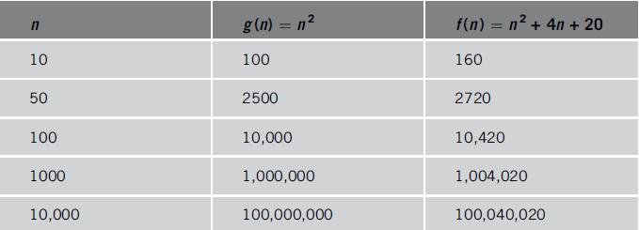
Algorithm Analysis: The Big-O Notation (cont’d.)
As n becomes larger and larger
  Term 4n + 20 in f(n) becomes insignificant
  Term n² becomes dominant term
  f(n) and g(n) are asymptotically equivalent as n -> ∞
TABLE 1-4 Growth rate of n² and n² + 4n + 20n
Data Structures Using C++ 2E

Slide 25
Algorithm Analysis: The Big-O Notation (cont’d.)
Algorithm analysis
  If function complexity can be described by complexity of a quadratic function without the linear term
    We say the function is of O(n²) or Big-O of n²
Let f and g be real-valued functions
  Assume f and g nonnegative
    For all real numbers n, f(n) >= 0 and g(n) >= 0
f(n) is Big-O of g(n): written f(n) = O(g(n))
  If there exists positive constants c and n₀ such that |f(n)| <= |cg(n)| for all n >= n₀
Data Structures Using C++ 2E

Slide 26
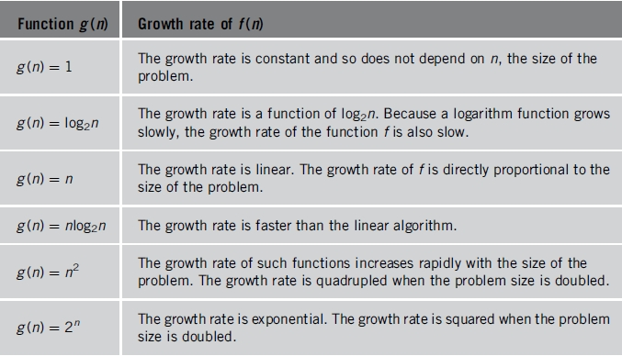
Algorithm Analysis: The Big-O Notation (cont’d.)
TABLE 1-5 Some Big-O functions that appear in algorithm analysis
Data Structures Using C++ 2E

Slide 27


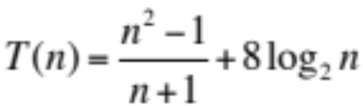

In Class Exercises
What is the best big O notation to describe the computing times
Data Structures Using C++ 2E
Notes:
O(n^3)
O(2^n)
O(n)
O(2^n)

Slide 28
In Class Exercises (cont’d)
What is the worst case computing time of the following in big O notation
// bubble sort
for (int i=0; I < n-1; i++) {
for (int j=0; j<n-1; j++) {
if (x[j] > x[j+1]) {
temp = x[j];
x[j]=x[j+1];
x[j+1]=temp;
}
}
// Matrix multiplication
for (int i=0; i<n; i++)
for (int j=0; j<n; j++) {
c[i][j]=0;
for (int k=0; k<n; k++)
c[i][j]+=a[i][k]*b[k][j];
}
// Calculate mean
n=0;
sum=0;
cin >> x;
while (x !=-999) {
n++;
sum+=x;
cin >> x;
}
Data Structures Using C++ 2E
Notes:
O(n^2),
O(n^3)
O(n)

Slide 29
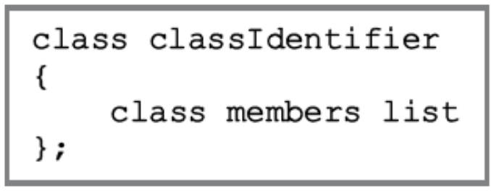
Classes
OOD first step: identify components (objects)
Encapsulation: object combines data and data operations in a single unit
Class: collection of a fixed number of components
  Class members: class components
  Class member categories
    private, public, protected
Data Structures Using C++ 2E

Slide 30
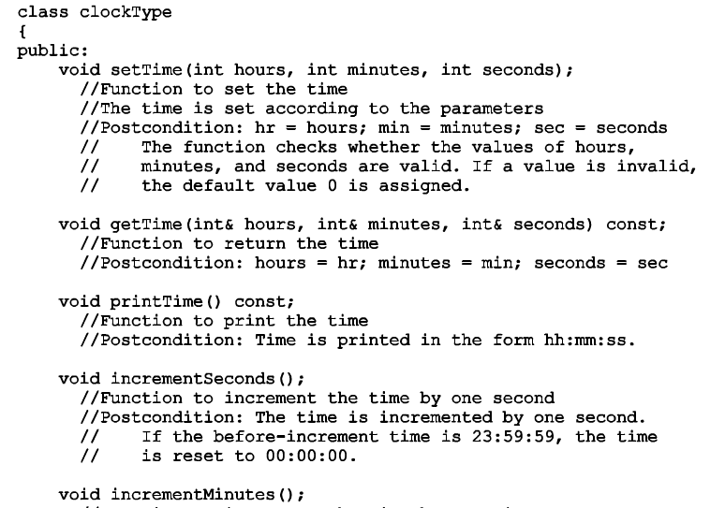
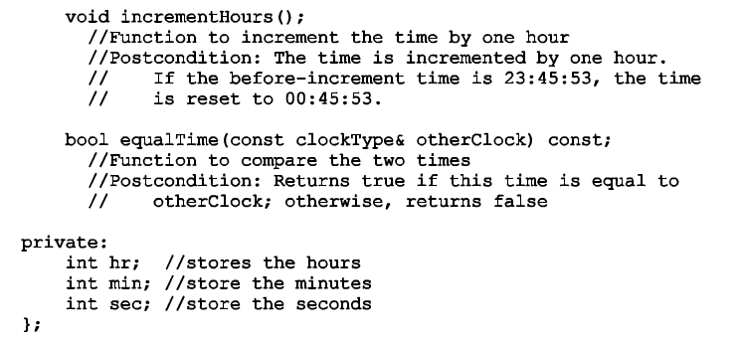
Data Structures Using C++ 2E

Slide 31
Classes (cont’d.)
Constructors
  Declared variable not automatically initialized
  With parameters or without parameters (default constructor)
  Properties
    Constructor name equals class name
    Constructor has no type
    All class constructors have the same name
    Multiple constructors: different formal parameter lists
    Execute automatically: when class object enters its scope
    Execution: depends on values passed to class object
Data Structures Using C++ 2E

Slide 32
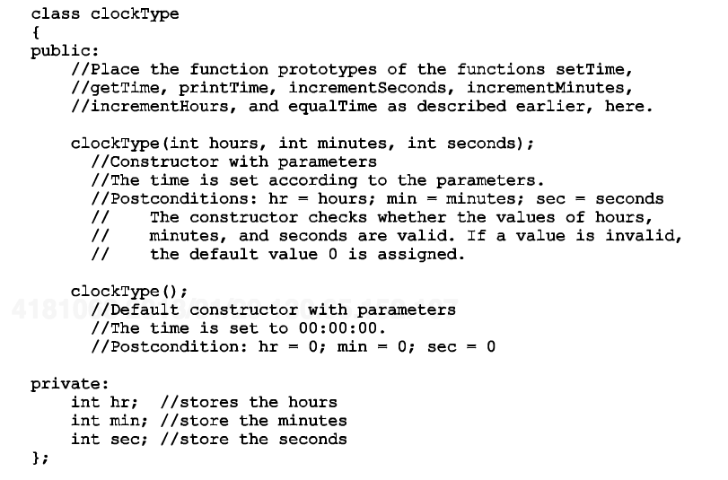
Data Structures Using C++ 2E

Slide 33
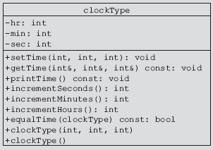
Classes (cont’d.)
Unified Modeling Language diagrams
  Graphical notation describing a class and its members
  Private and public members
FIGURE 1-5 UML class diagram of the class clockType
Data Structures Using C++ 2E

Slide 34
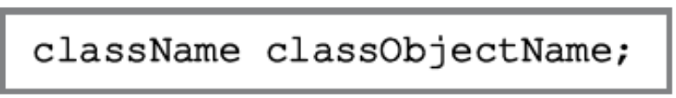
Classes (cont’d.)
Variable (object) declaration
  Once class defined
    Variable declaration of that type allowed
  Class variable
    Called class object, class instance, object in C++
  A class can have both types of constructors
  Upon declaring a class object
    Default constructor executes or constructor with parameters executes
Data Structures Using C++ 2E

Slide 35

Classes (cont’d.)
Accessing class members
  When an object of a class is declared
    Object can access class members
  Member access operator
    The dot, . (period)
  Class members accessed by class object
    Dependent on where object declared
Data Structures Using C++ 2E

Slide 36
Classes (cont’d.)
clockType myClock;
clockType yourClock(5, 12, 40);
myClock.setTime(5, 2, 30);
myClock.printTime();
If (myClock.equalTime(yourClock)) {
…
}
Data Structures Using C++ 2E

Slide 37
Classes (cont’d.)
Implementation of member functions
  Reasons function prototype often included for member functions
    Function definition can be long, difficult to comprehend
    Providing function prototypes hides data operation details
  Writing definitions of member functions
    Use scope resolution operator, :: (double colon), to reference identifiers local to the class
Data Structures Using C++ 2E

Slide 38
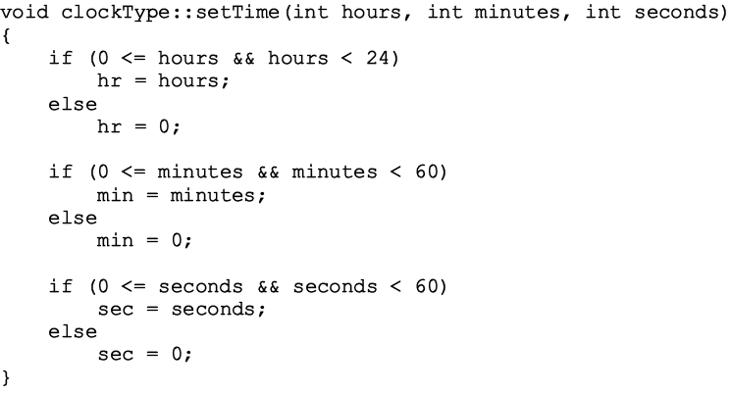
Classes (cont’d.)
Implementation of member functions (cont’d.)
  Example: definition of the function setTime
Data Structures Using C++ 2E

Slide 39
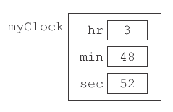
Classes (cont’d.)
Implementation of member functions (cont’d.)
Execute statement myClock.setTime(3,48,52);
FIGURE 1-6 Object myClock after the statement
myClock.setTime(3, 48, 52); executes
Data Structures Using C++ 2E

Slide 40
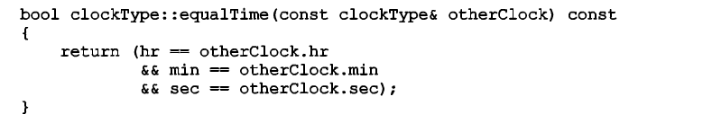
Classes (cont’d.)
Implementation of member functions (cont’d.)
  Example: definition of the function equalTime
Data Structures Using C++ 2E

Slide 41
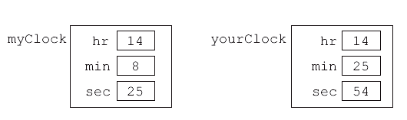
Classes (cont’d.)
Implementation of member functions (cont’d.)
  Objects of type clockType
    myClock and yourClock
FIGURE 1-7 Objects myClock and yourClock
Data Structures Using C++ 2E

Slide 42
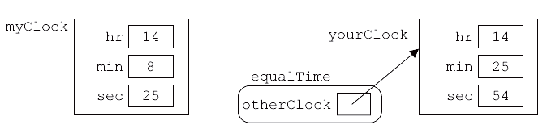
Classes (cont’d.)
Implementation of member functions (cont’d.)
  if(myClock.equalTime(yourClock)) …
    Object myClock accesses member function equalTime
    otherClock is a reference parameter
    Address of actual parameter yourClock passed to the formal parameter otherClock
FIGURE 1-8 Object myClock and parameter otherClock
Data Structures Using C++ 2E

Slide 43
Classes (cont’d.)
Implementation of member functions (cont’d.)
  equalTime execution
  Variables hr , min , sec in equalTime function body
    Instance variables of variable myClock
  Once class properly defined, implemented
    Can be used in a program
  Client
    Program or software using and manipulating class objects
  Instance variables
    Have own instance of data
Data Structures Using C++ 2E

Slide 44
Classes (cont’d.)
Reference parameters and class objects (variables)
  Variable passed by value
    Formal parameter copies value of the actual parameter
  Variables requiring large amount of memory and needing to pass a variable by value
    Corresponding formal parameter receives copy of the data of the variable
  Variable passed by reference
    Corresponding formal parameter receives only the address of the actual parameter
Data Structures Using C++ 2E

Slide 45
Classes (cont’d.)
Reference parameters and class objects (variables) (cont’d.)
  Disallow changing values of actual parameter
    Declare as a reference parameter using the keyword const
  If the formal parameter is a value parameter
    Can change the value within function definition
  If formal parameter is a constant reference parameter
    Cannot change value within the function
    Cannot use any other function to change its value
Data Structures Using C++ 2E

Slide 46
Classes (cont’d.)
Reference parameters and class objects (variables) (cont’d.)
  Two built-in operations
    Member access (.)
    Assignment (=)
Assignment operator and classes
  Assignment statement performs a memberwise copy
  Example: myClock = yourClock;
    Values of the three instance variables of yourClock
    copied into corresponding instance variables of myClock
Data Structures Using C++ 2E

Slide 47
Classes (cont’d.)
Class scope
  Automatic
    Created each time control reaches declaration
    Destroyed when control exits surrounding block
  Static
    Created once when control reaches declaration
    Destroyed when program terminates
  Can declare an array of class objects: same scope
  Member of a class: local to the class
  Access (public) class member outside the class
    Use class object name, member access operator (.)
Data Structures Using C++ 2E

Slide 48
Classes (cont’d.)
Functions and classes
  Rules
    Class objects passed as parameters to functions and returned as function values
    Class objects passed either by value or reference as parameters to functions
    Class objects passed by value: instance variables of the actual parameter contents copied into the corresponding formal parameter instance variables
Data Structures Using C++ 2E

Slide 49
Classes (cont’d.)
Constructors and default parameters
  Constructor can have default parameters
  clockType clockType(int = 0, int = 0, int =0);
  Rules declaring formal parameters
    Same as declaring function default formal parameters
  Actual parameters passed with default parameters
    Use rules for functions with default parameters
  Default constructor
    No parameters or all default parameters
    clockType clock1;
    clockType clock2(5);
Data Structures Using C++ 2E

Slide 50
Classes (cont’d.)
Destructor
  Function
  No type
  Neither value-returning nor void function
  One destructor per class
    No parameters
  Name
    Tilde character (~) followed by class name
      clockType ~clockType();
  Automatically executes
    When class object goes out of scope
Data Structures Using C++ 2E

Slide 51
Classes (cont’d.)
Structs
  Special type of classes
  All struct members public
  C++ defines structs using the reserved word struct
  If all members of a class are public, C++ programmers prefer using struct to group the members
  Defined like a class
Data Structures Using C++ 2E

Slide 52
Data Abstraction, Classes, and Abstract Data Types
Abstraction
  Separating design details from use
Data abstraction
  Process
    Separating logical data properties from implementation details
Abstract data type (ADT)
  Data type separating logical properties from implementation details
  Includes type name, domain, set of data operations
Data Structures Using C++ 2E

Slide 53
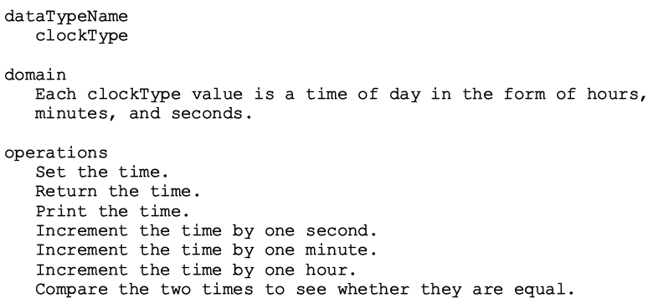
Data Abstraction, Classes, and Abstract Data Types (cont’d.)
ADT
  Example: defining the clockType ADT
Data Structures Using C++ 2E

Slide 54
Data Abstraction, Classes, and Abstract Data Types (cont’d.)
Implementing an ADT
  Represent the data; write algorithms to perform operations
  C++ classes specifically designed to handle ADTs
Data Structures Using C++ 2E

Slide 55
Identifying Classes, Objects, and Operations
Object-oriented design
  Hardest part
    Identifying classes and objects
Technique to identify classes and objects
  Begin with problem description
  Identify all nouns and verbs
    From noun list: choose classes
    From verb list: choose operations
Data Structures Using C++ 2E

Slide 56
Summary
Algorithms
Big O notation
Object-oriented design principles
  Encapsulation
  Inheritance
  Polymorphism
Class: collection of fixed number of components
  Member variables + member functions
  Constructors: initialize class instance variables
  Destructor: cleanup, only one per class
Data Structures Using C++ 2E

Slide 57
Summary (cont’d.)
UML diagrams: graphical notation describing class and its members
Abstract data type (ADT)
Data Structures Using C++ 2E

Slide 58
Self Exercises
Programming Exercises: 1, 2, 6
Data Structures Using C++ 2E

